Slide 1
CheapChicago (formerly known as Take me away)
CS122 Project – Final presentation
Computer Science with Applications 2
Hector Salvador and Carlos Grandet
March 10th, 2016

Slide 2

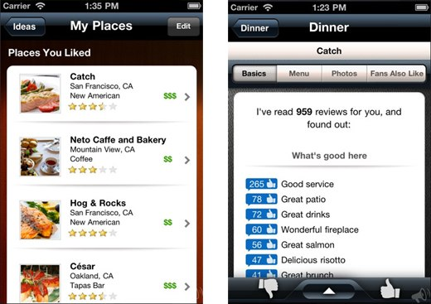
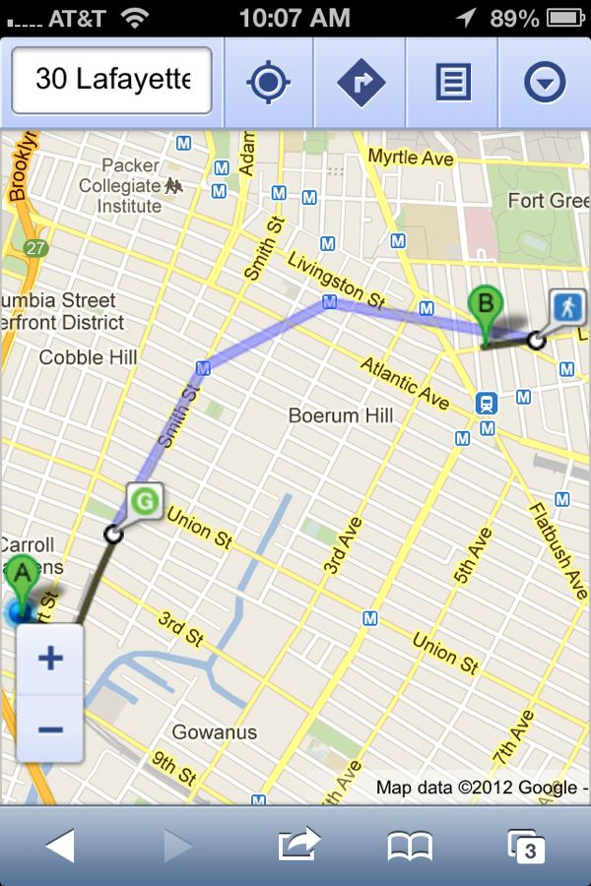
Goal
Develop a website suggesting :
Affordable places
Attractive and well-rated locations
With characteristics you like!
Personalized options
Suggests places
Maps destinations

Slide 3
How did we do it?
Getting the information
Scoring places
Visualizing results
Yelp: scraping and API
Individual ratings and comments were not available from the API
Scraping was convenient as we could “pre-filter” businesses by neighborhood, price, and type
Score based on:
Price, “$, $$” from Yelp
Ratings, weighted ratings according to the days passed since its posting
Distance, calculated from a “gravity” center of places
Attributes, matched from the key words checked on the website
Django interface
Return the three best-scored locations from the selected categories
Show suggested spots in a map using Google Static Maps API

Slide 4
Interesting features
OAuth2 & Python 2.7
OAuth2 library is widely used to authenticate users using APIs
Non-compatible with Python 3
Downloaded Yelp data using Python 2.7
Google Static Maps API
No need to authenticate
Calls API through a url with certain syntax
Put a key at the end of url
https://maps.googleapis.com/maps/api/staticmap?
size=512x512 & maptype=roadmap & markers=color:purple%7Clabel:1%7C5420+N+Clark+St,Chicago & key = AIzaSyCyV611rvT1sv…
Scoring
Sum of four individual ratings:
Price, takes 0.5 (if “$$”) or 1 (if “$”) value
Ratings, discount ratings with hyperbolic discounting
Distance, creates a “gravity center” based on price and weight scores, then calculates the normalized distance between the center and the business/location
Attributes, detects the number of words found on the business matching the provided words

Slide 5
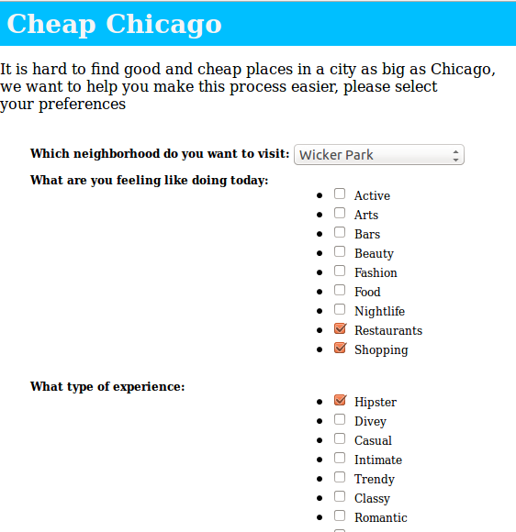
Demo

Slide 6

Challenges and surprises
Scraping Yelp’s website took considerable amount of time:
Too long to create beautifulsoup objects
Some places had hundreds of reviews which took too long to read (>5 sec/page and every page had only 20 reviews)
We got banned several times.

Slide 7
Challenges and surprises
Yelp’s data
Weird or incomplete addresses:
Breaking Bread Lunch in River North: 1871 Kitchen, 222 W Merchandise Mart Plz, 12th Fl
No opening or closing times
Limited to what people post on Yelp (ratings and comments)
Scoring
Current score weights too much good ratings and not so much matches with key words: Potbelly
Places recommended might be irrelevant: CVS, Passport & Visa Photo?
Dropped the feature of getting from point A to B in shortest possible time

Slide 8
Next steps
Improve scoring algorithms:
Text analysis from reviews to get attributes from establishments
Make more specific categories (bagels, shopping)
Use clustering algorithms to weigh distance
Make a more dynamic website
Use Javascript to make a responsive form
Make interactive map (Google Maps API)

